Slide 1

Marketing Report
May 2023

Slide 2

Website

Slide 3
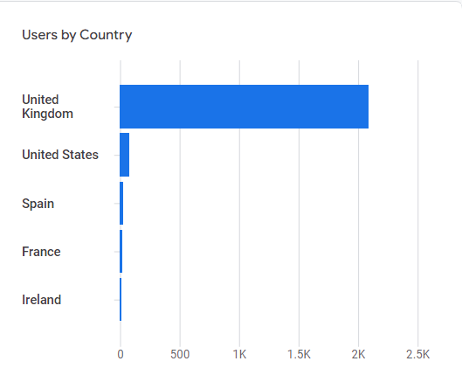
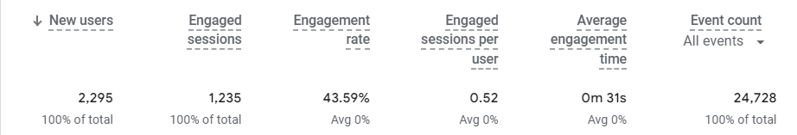
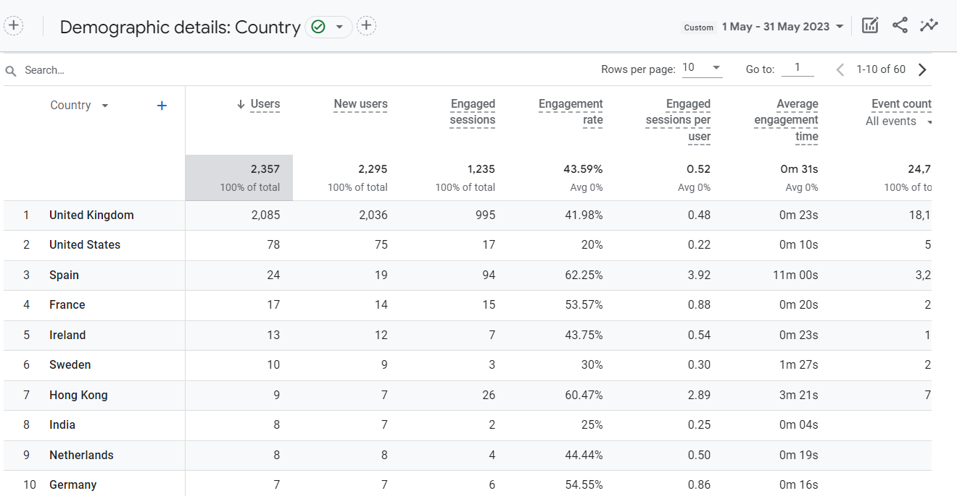
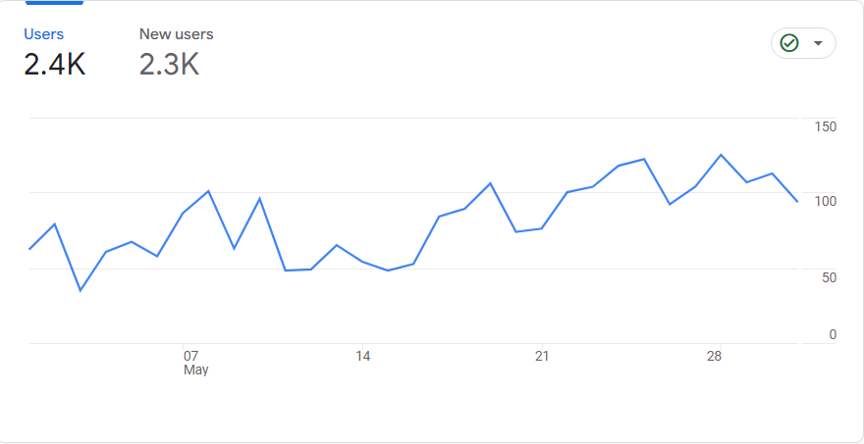

Website Traffic- User Engagement per Country

Slide 4
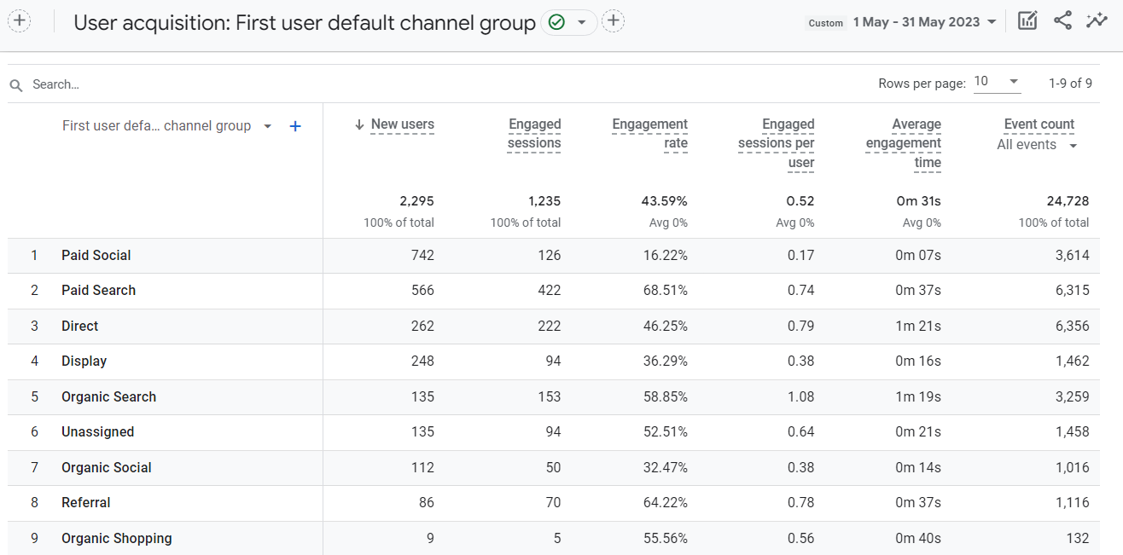
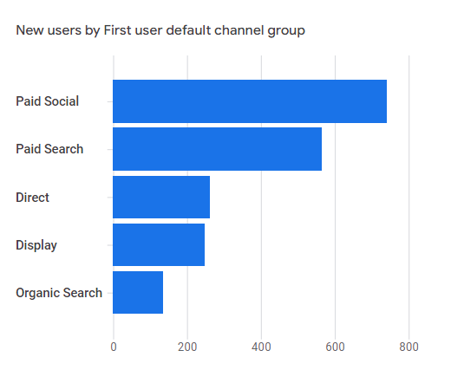
Website Traffic Performance May- User Acquisition per session channel

Slide 5
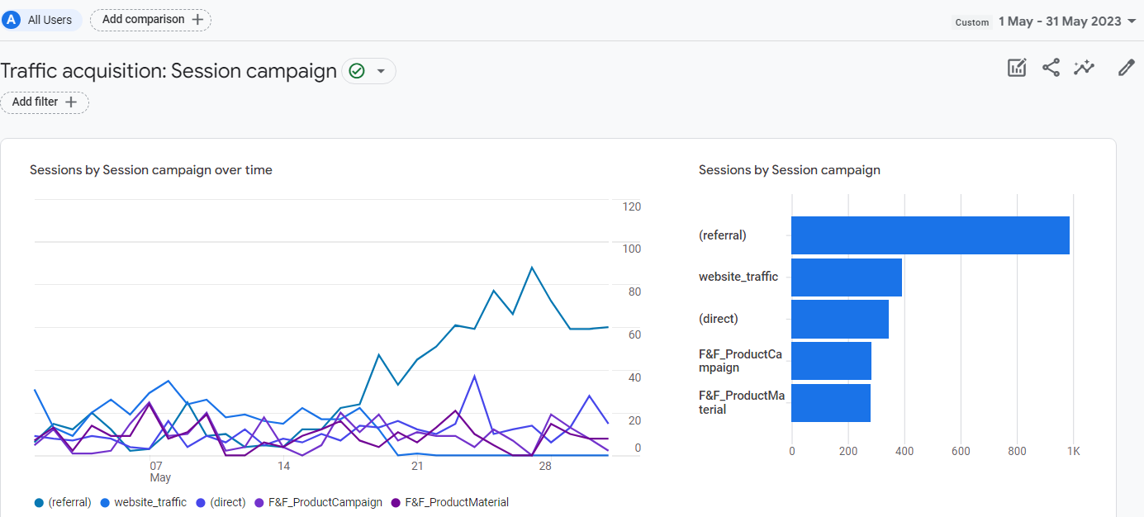
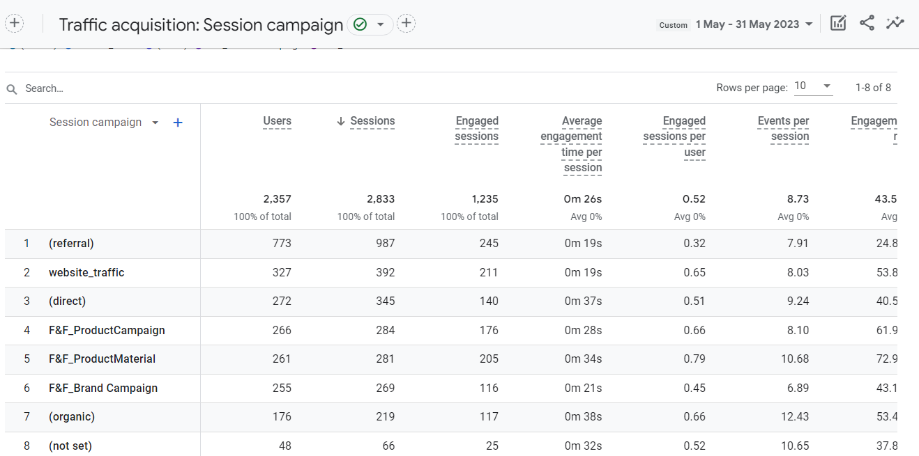
Google Ads Campaign Website Traffic Performance May

Slide 6
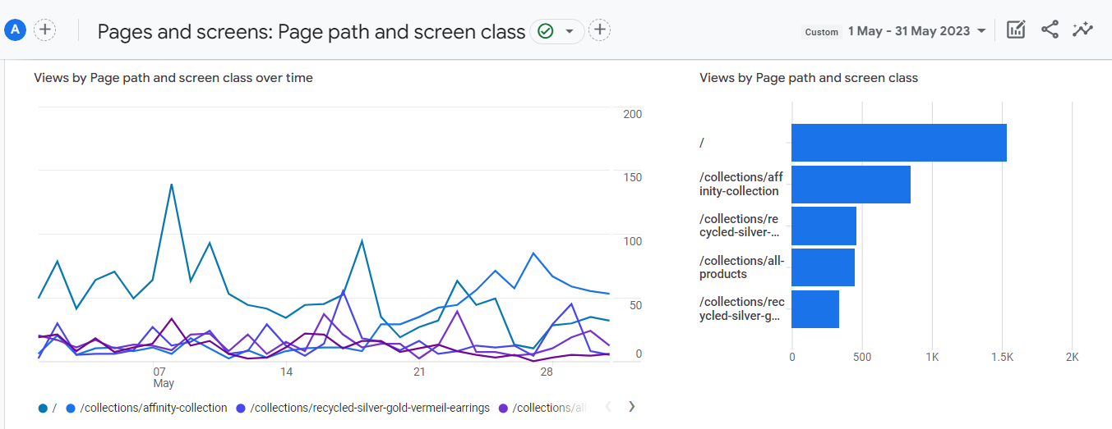
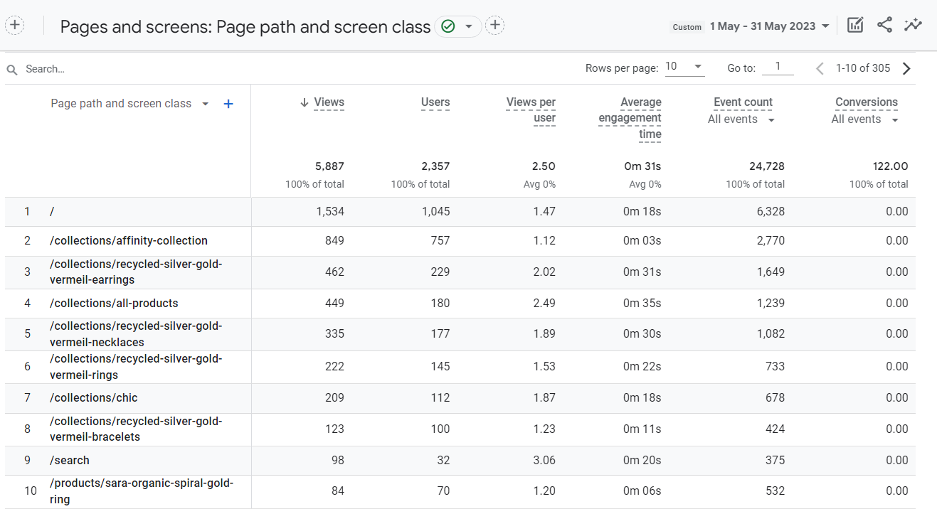
Website Traffic Performance May- Pages and Screens

Slide 7
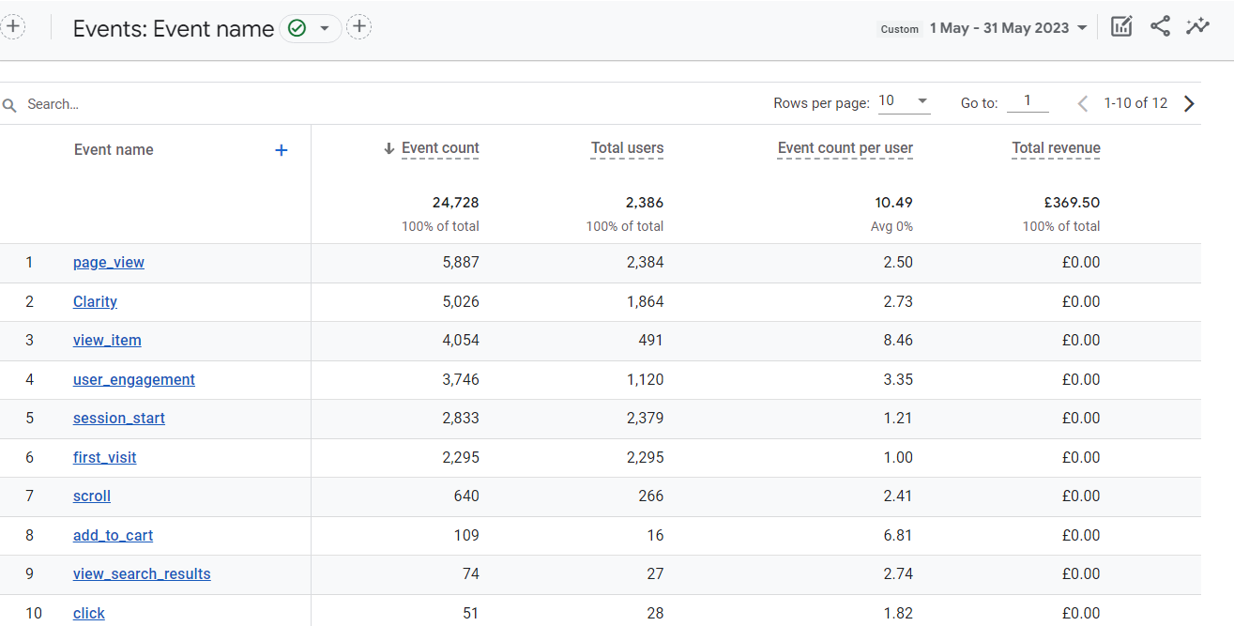
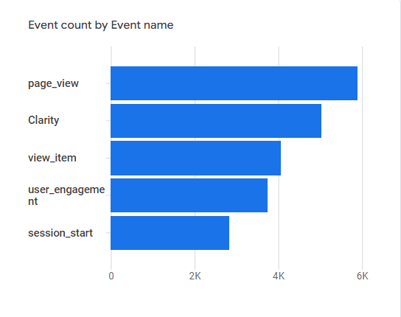
Website Traffic Performance May- Events, Conversions & Revenue

Slide 8
Website (SEO, optimization & design)
In MAY 2023, Xplore Digital improved the website of Frida & Florence with the following changes:
SEO changes:
Fixed h1 SEO issue on home. Added new h1.
Changed meta-description home.
Web optimization:
Edited review dates & removed unwanted data from the section.
Added Privacy text to the subscription button. Deactivated subscription confirmation email.
Website design
Restyled buttons (on the entire website)
Restyled product category buttons (on the home).
Restyled h1, h2, h3 (on blog).
Edited colour (on footer).
Edited colour (on popup + tab).
Edited colour (on top banner announcement bar).
Edited collection collage (on product pages).
Changed colours and sizes (of titles).
Edited “Featured in” section.
Edited Pagination.
Added Material filter to Header menu.
Uploaded Pollock collection.
Added article with links and images.

Slide 9

F&F-Blog article May
F&F
In MAY 2023, Xplore Digital created a blog article for the Frida & Florence website:
Blog article:
Eco-friendly jewelry sustainable and stylish accessories

Slide 10
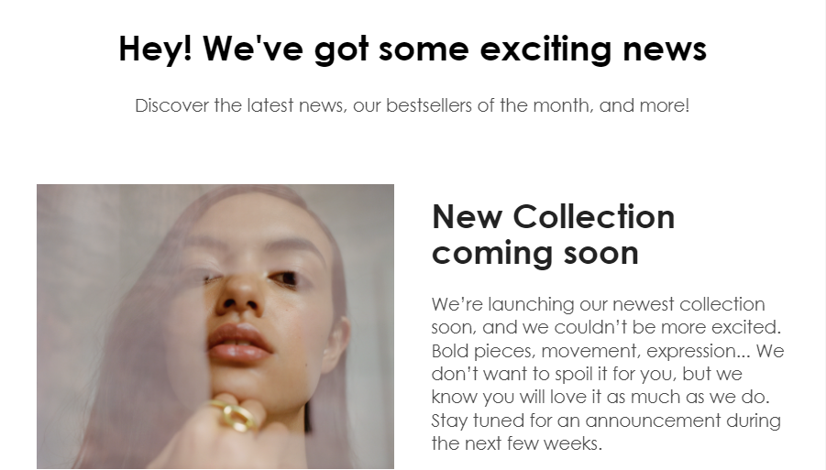
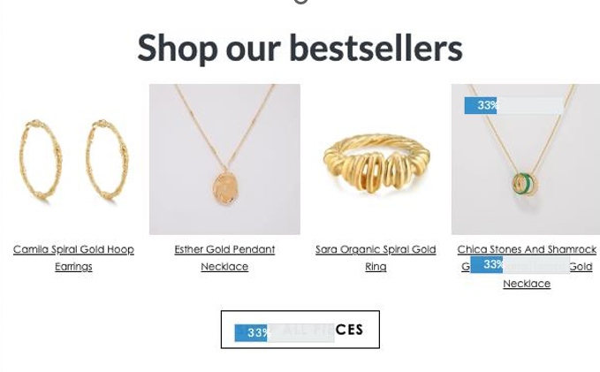
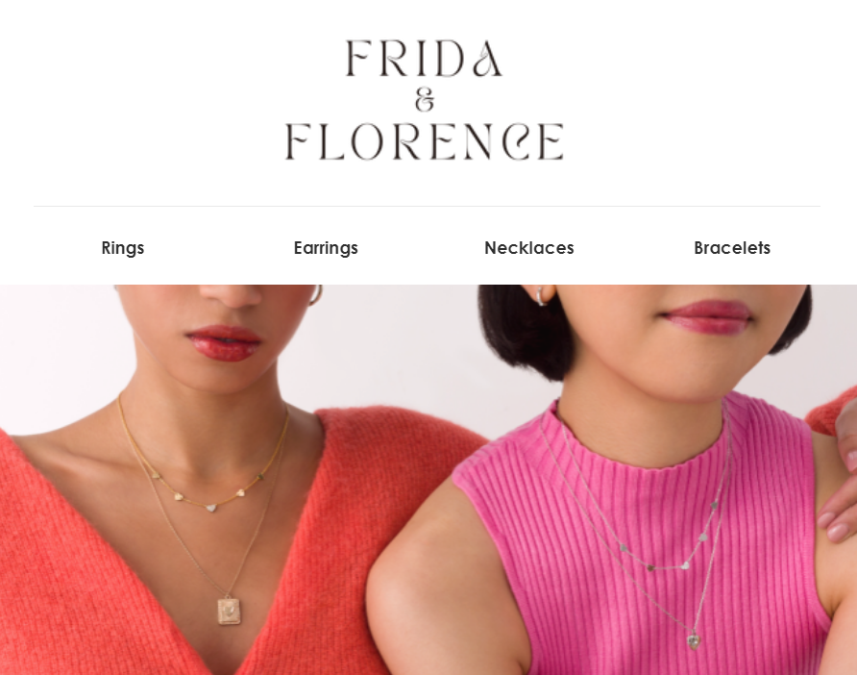
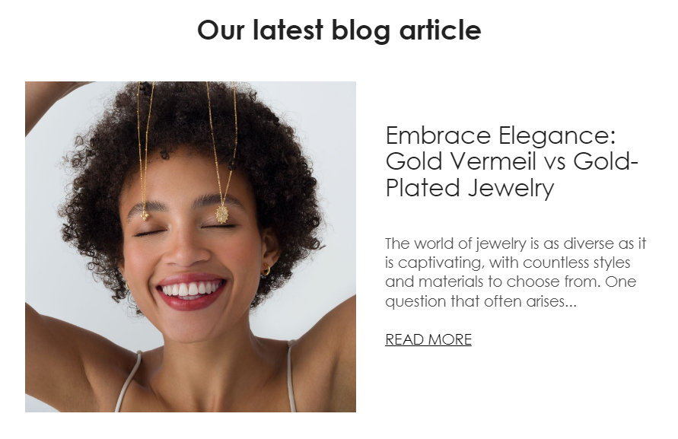
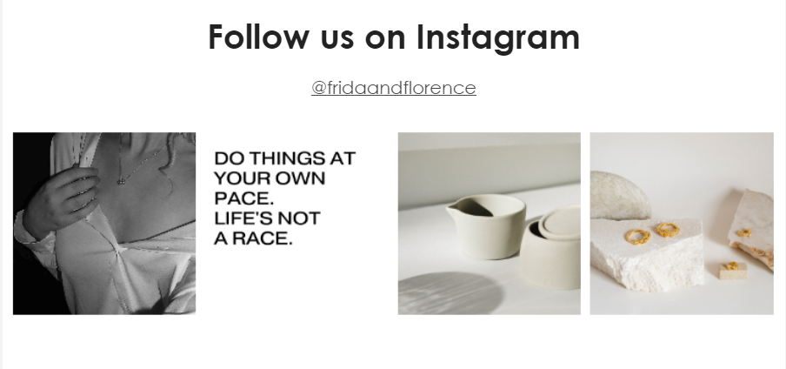
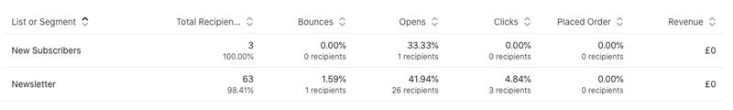
F&F- Newsletter May
In MAY 2023, Xplore Digital styled and developed the first Frida & Florence Newsletter:
Newsletter:
Hey! We've got some exciting news.
NEWSLETTER MAY
STATS
Click Rate: 33%
Opening rate: 41,94%

Slide 11
Website optimization- Next Month
In June 2023, Xplore Digital will work on the following:
Website optimization:
Website design
Modify sections to promote the new collection
Newsletter
Create Monthly Newsletter June: presentation of the new collection

Slide 12

Social Media

Slide 13
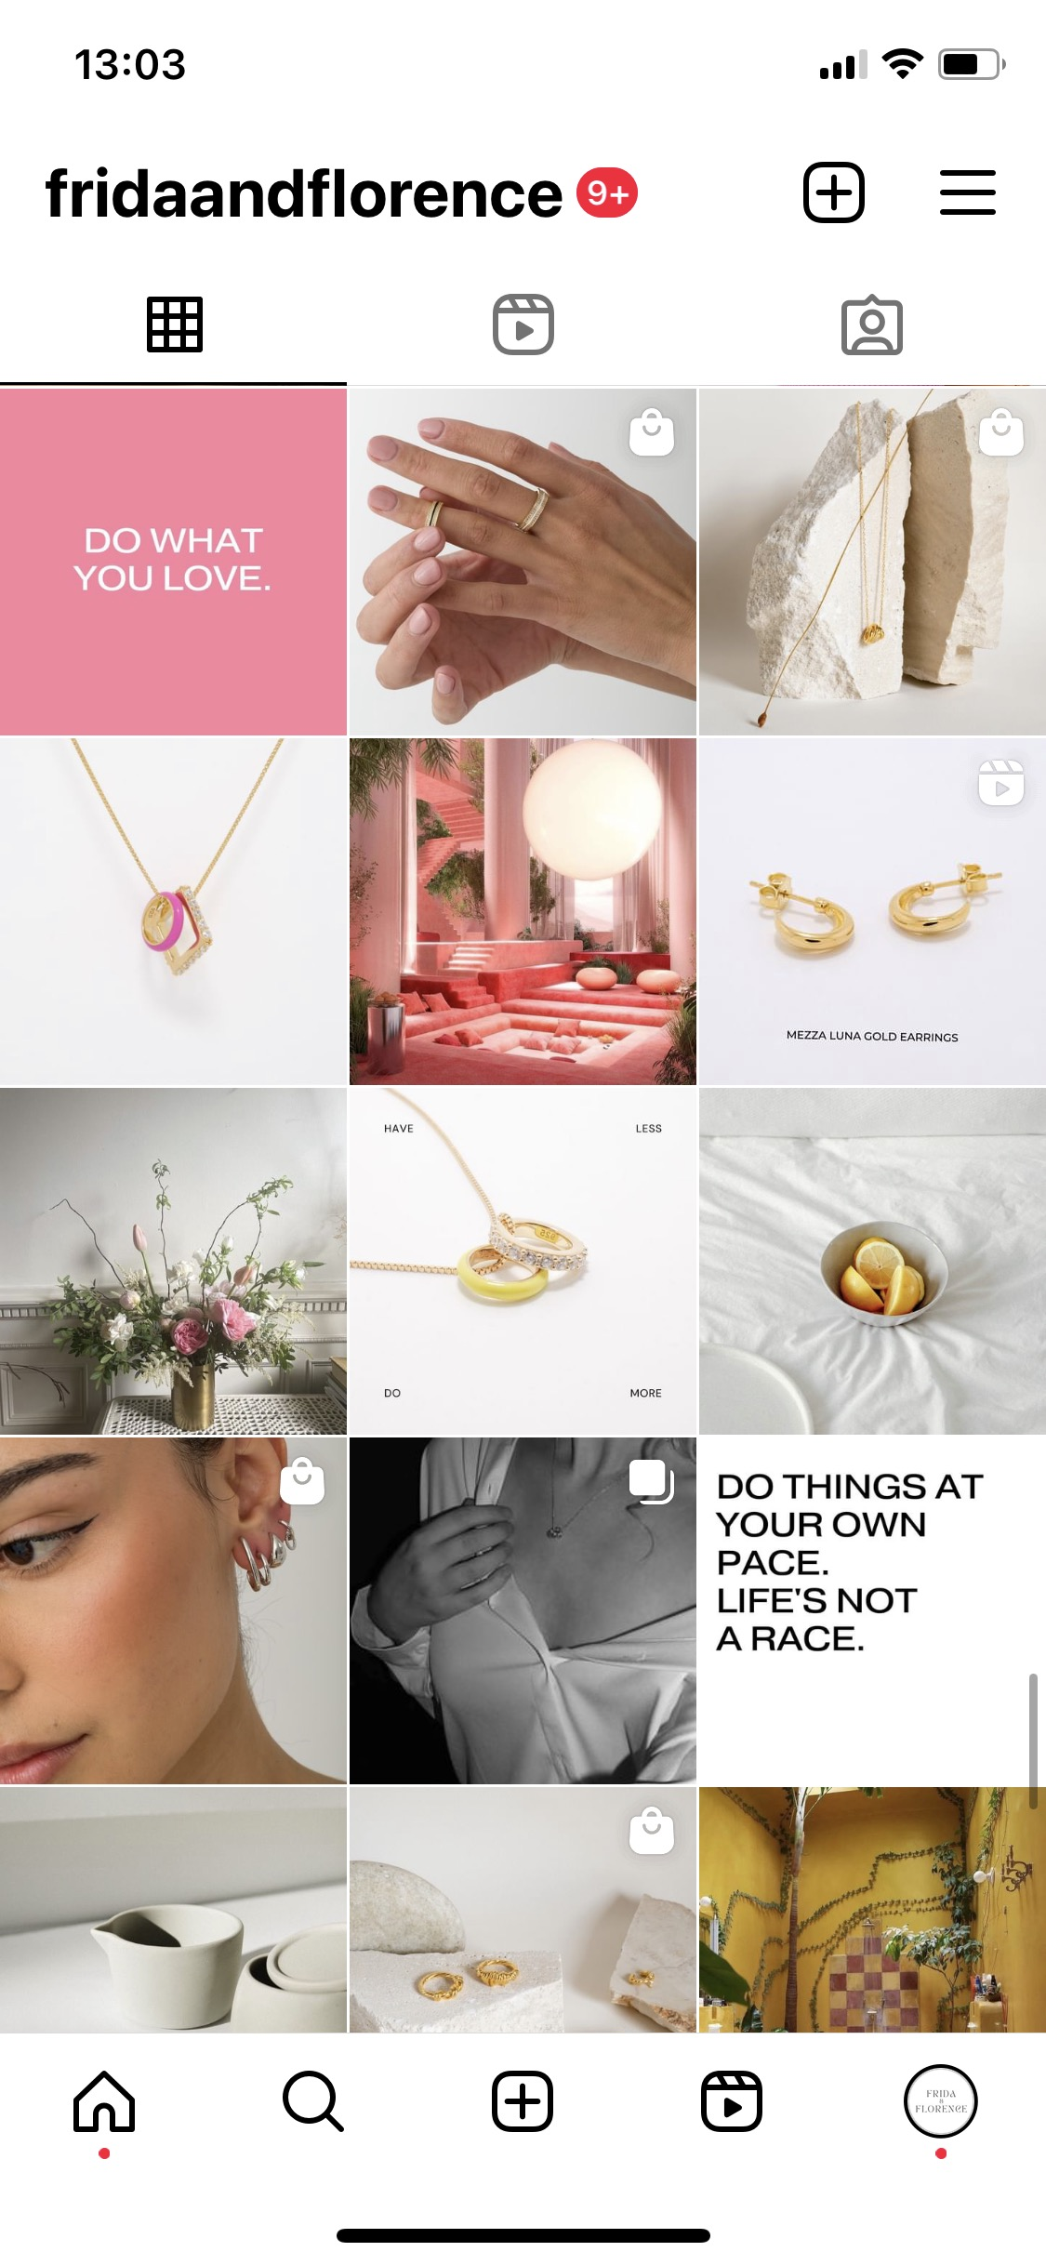
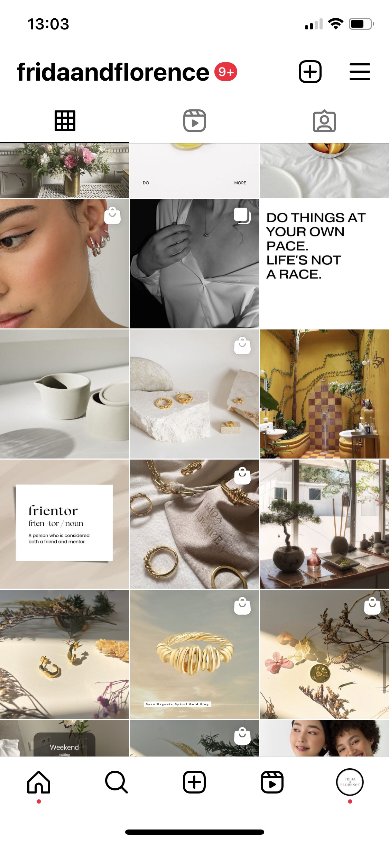
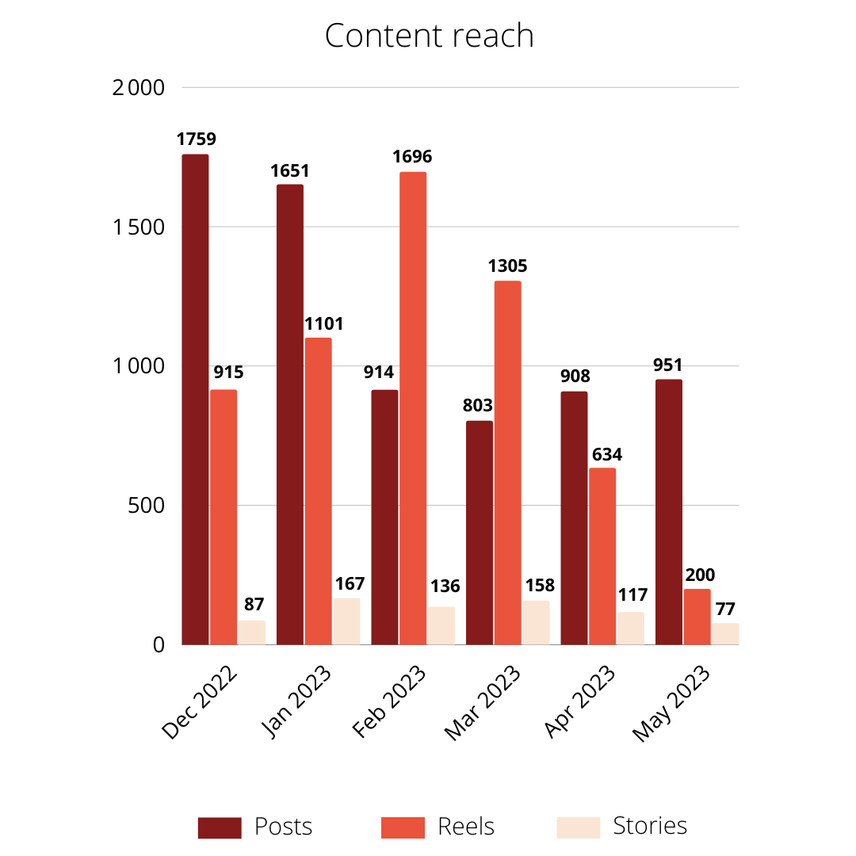
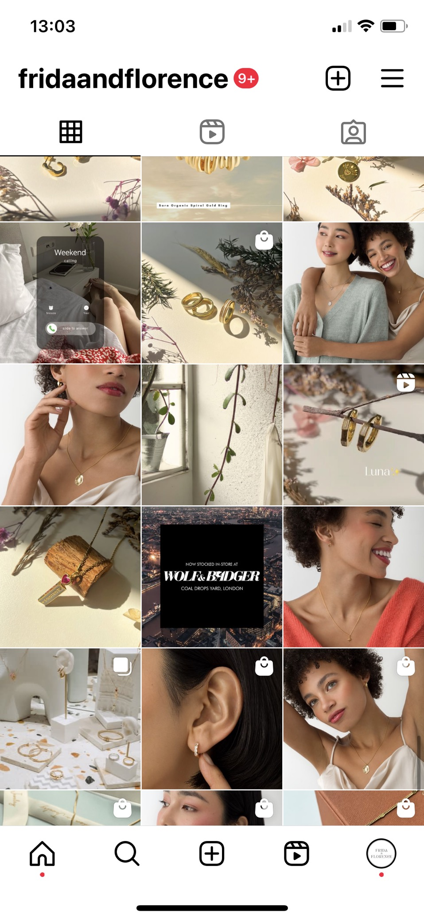
Instagram metrics – Overview
In May, we have posted:
29 posts
4 stories
1 reels
Overview
May(1-31), compared to April(1-30) 2023
Accounts reached
> 594K (-21,2% compared to Apr)
Accounts engaged
> 417 (-40,6% compared to Apr)
Total Followers
> 8,676
.

Slide 14
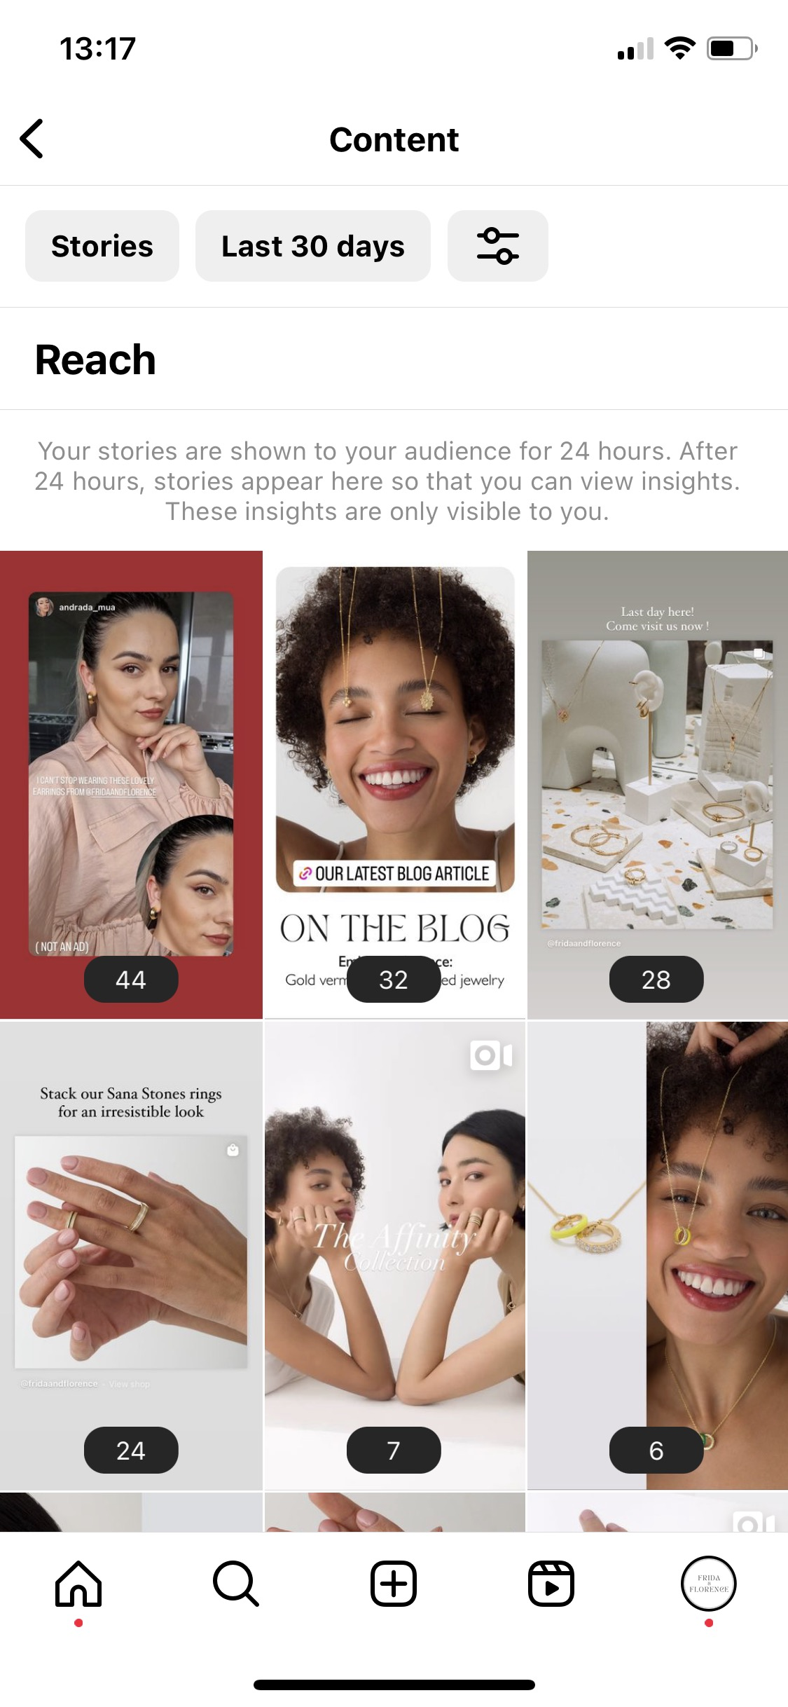
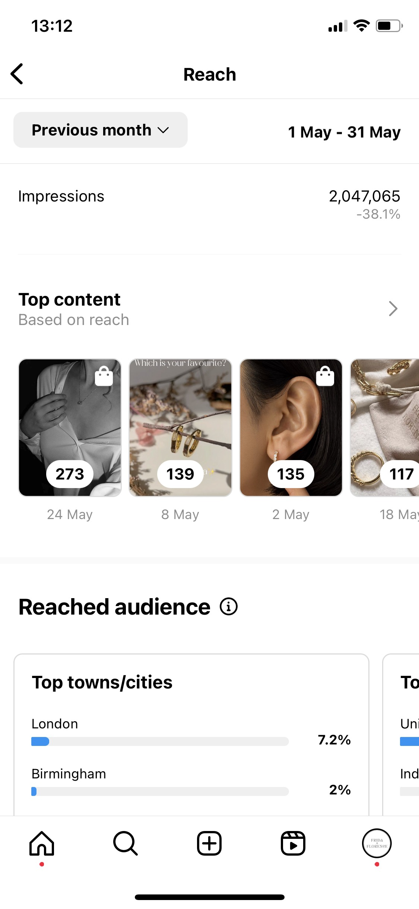
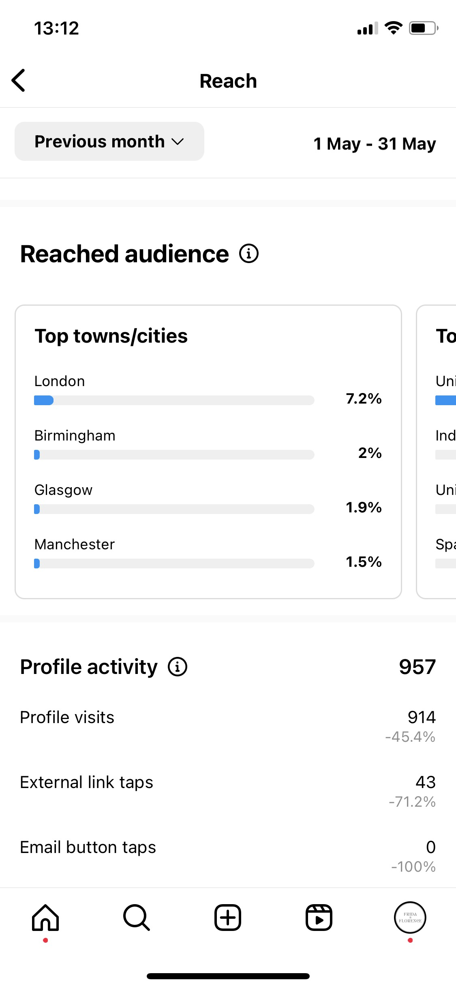
Instagram metrics – Content reach
Reach
Top Content
1. May 24 | Post
273 accounts reached
7 content interactions
2. May 8 | Reel
139 accounts reached
4 content interactions
3. May 2 | Post
135 accounts reached
6 content interactions
4. May 18 | Post
117 accounts reached
12 accounts interactions
5. May 20 | Post
101 accounts reached
9 post interactions
.

Slide 15
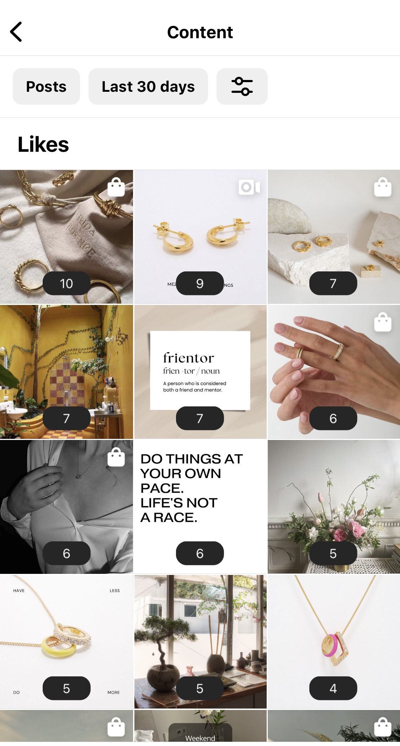
Instagram metrics – Content interaction
531 content interactions in May
(-30,1% compared to Apr)
Posts interactions: 179
> Likes: 155
> Comments: 4
> Saves: 16
> Shares: 4
Reels interactions: 6
> Likes: 6

Slide 16
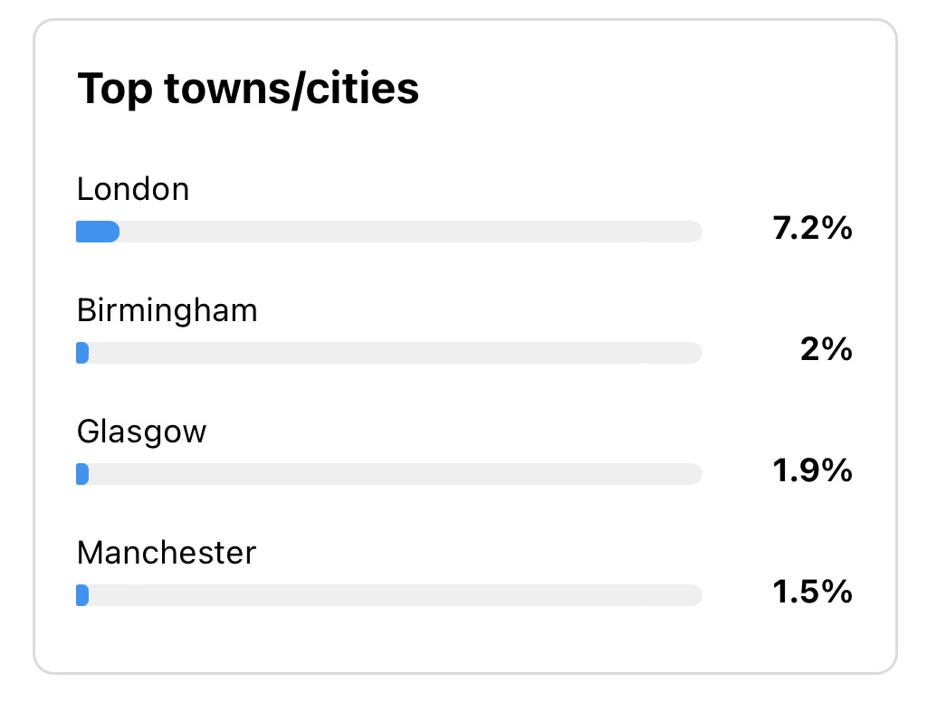
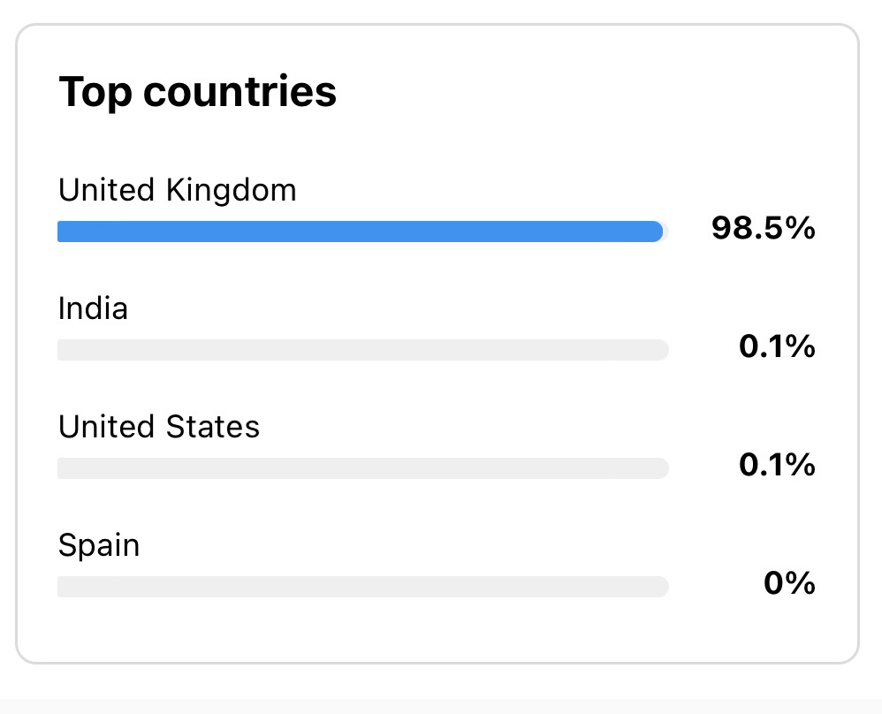
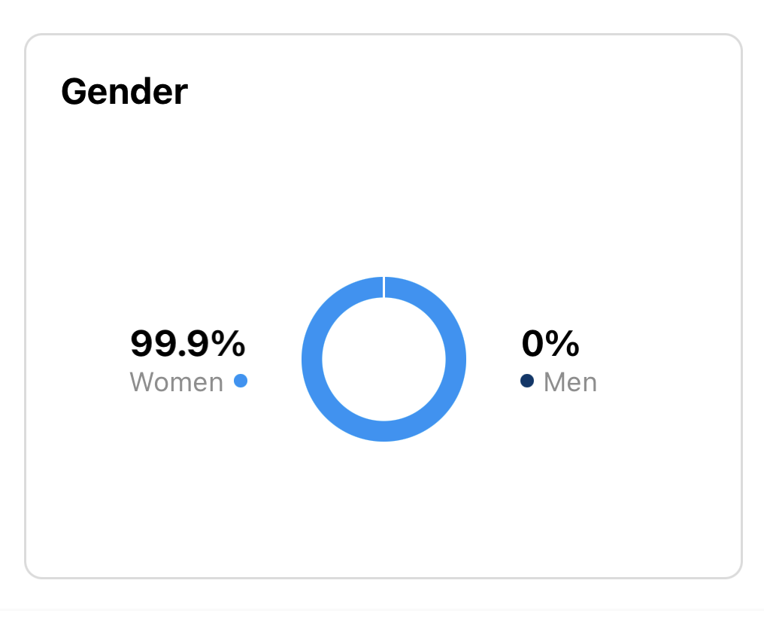
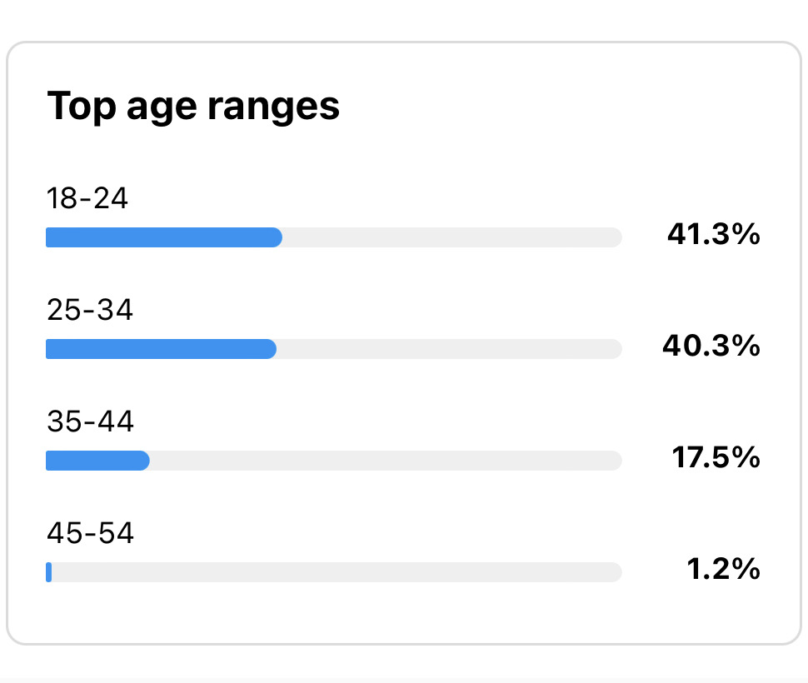
Instagram metrics – Reached audience May

Slide 17
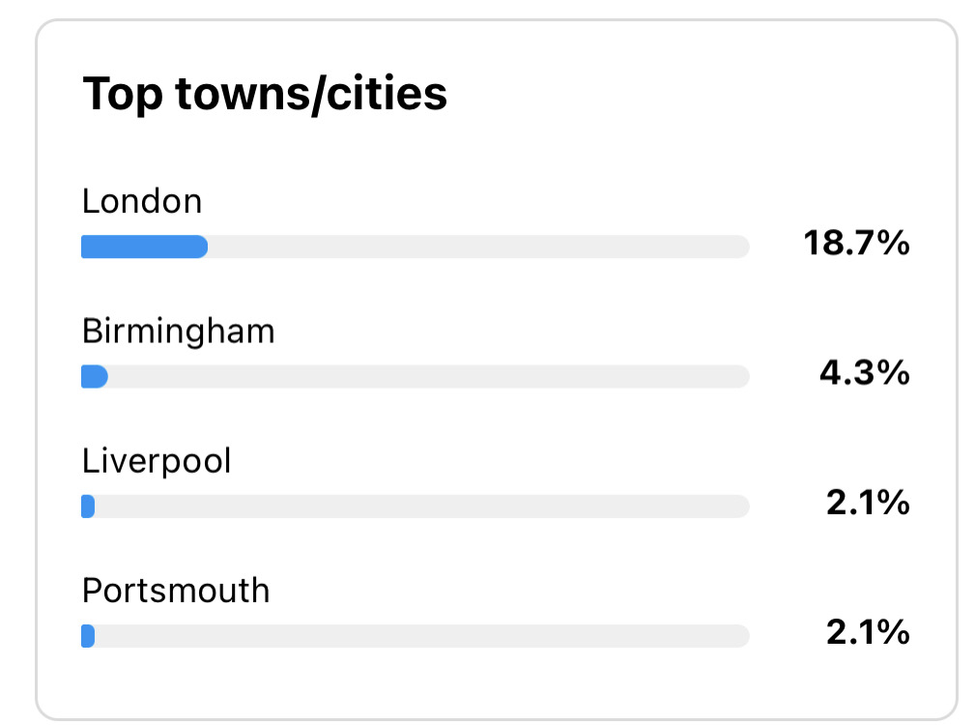
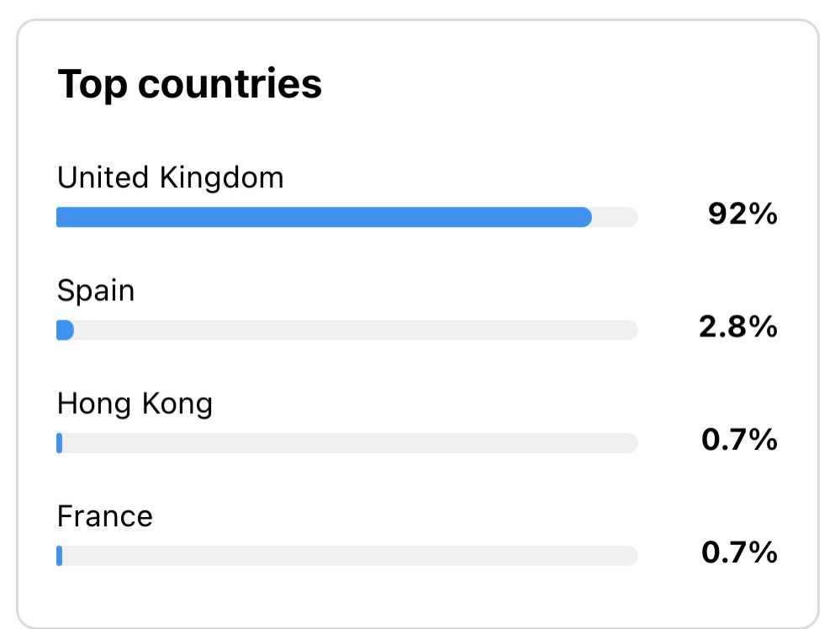
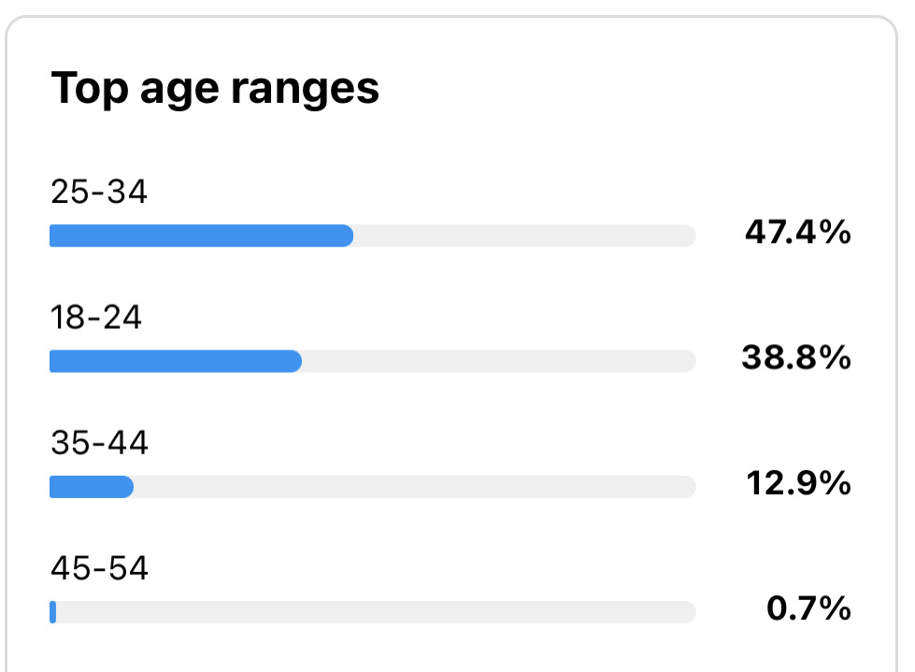
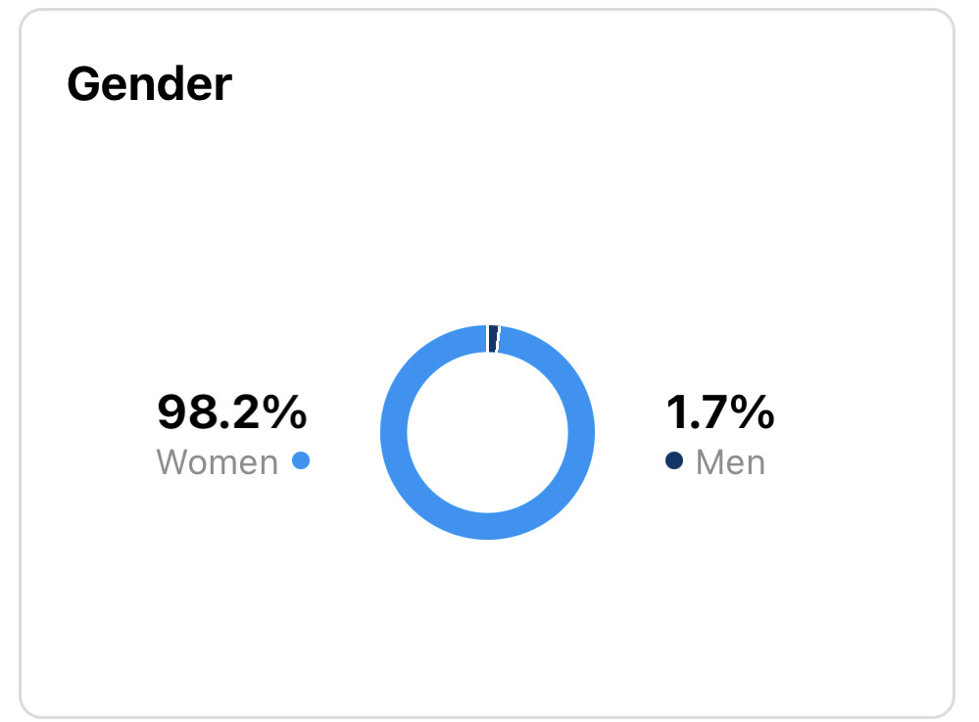
Instagram metrics – Engaged audience May

Slide 18
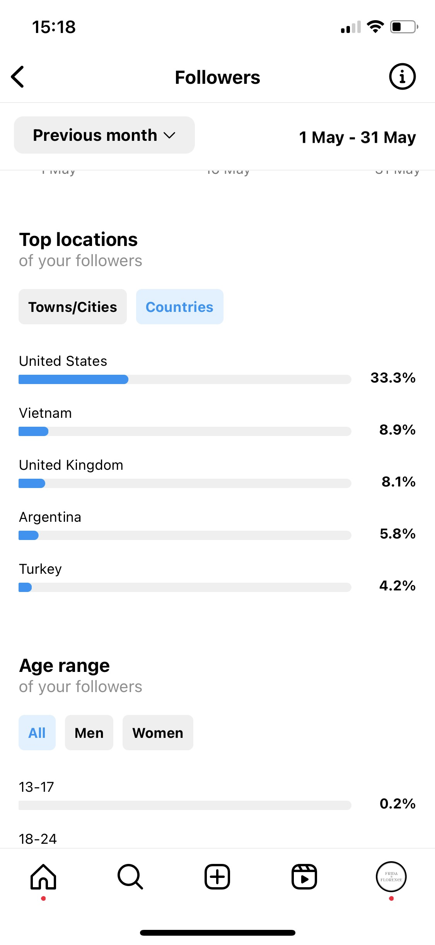
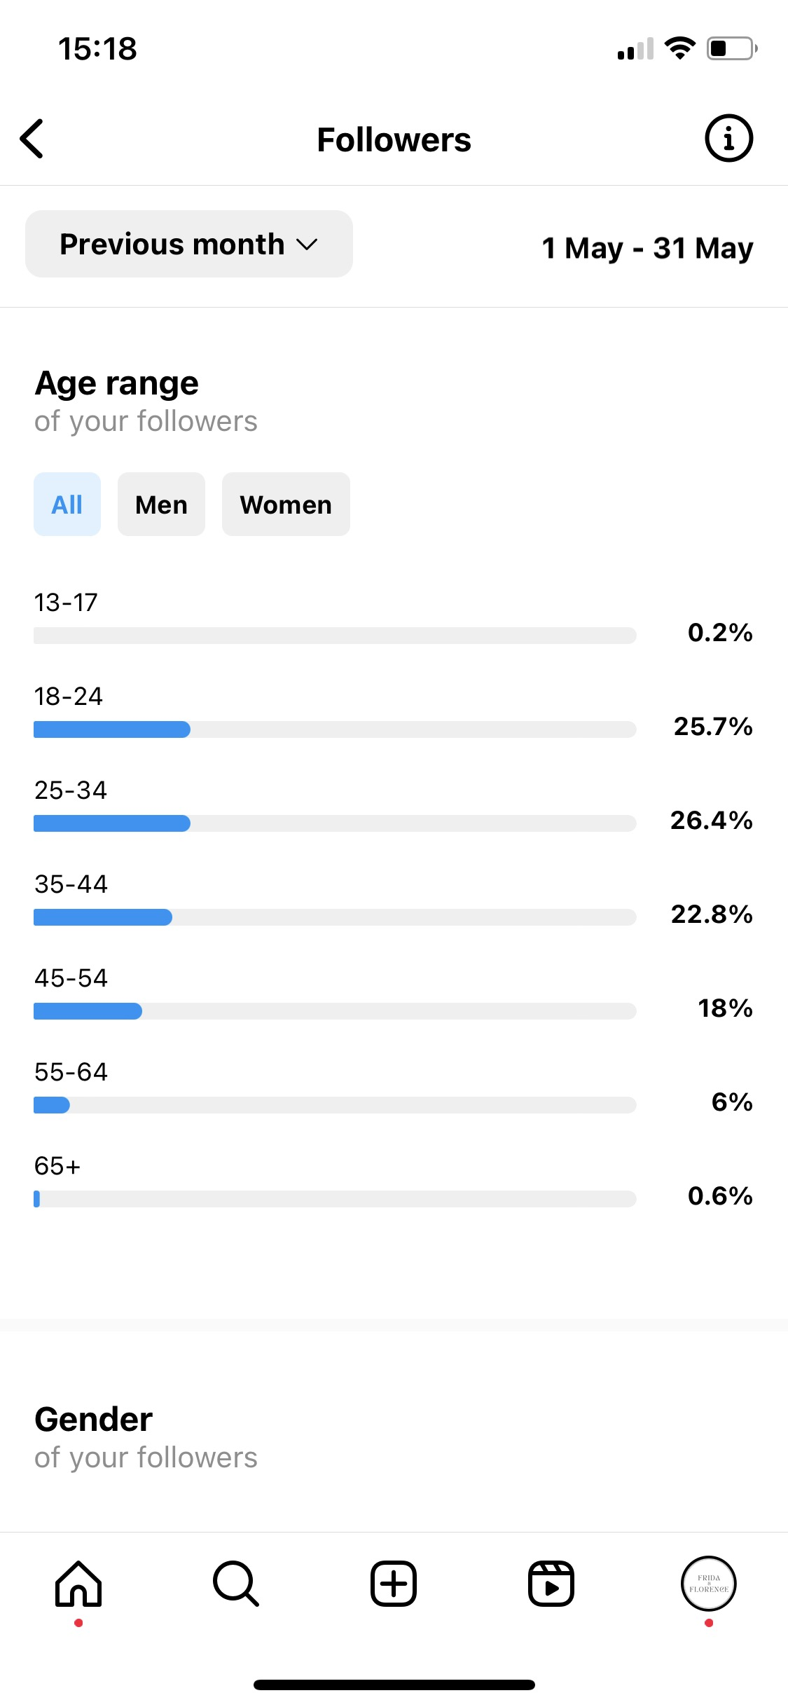
Instagram metrics – Followers May

Slide 19
Social media – Next steps for June
What's next ?
Objectives
Launch of Pollock Collection
Post stories on a more regular basis > improve visibility amongst followers
Facebook Ad strategy for June
Facebook Ad strategy for the launch of Pollock Collection > organisation of a contest/giveaway
Increase the number of followers that could be potential clients > increase followers' engagement
Increase content interactions > create impactful and eye-catching content (reels work the best)

